Slide 1

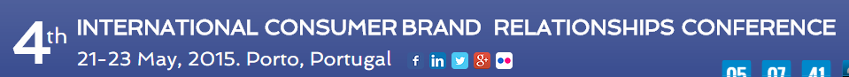
Buy Original or Counterfeit Luxury Products?
The Importance of
Brand Attachment and Self Image
-01 00 00
00
00
00
Adriano Ayres, Fumec University Brazil
Cid Gonçalves Filho, Fumec University Brazil
Euler Alves Brandão, StetikGroup Brazil

Slide 2



Fumec Univertisty
15.000 students
460 professors
City of Belo Horizonte
(3rd in population - Brazil)

Slide 3
Introduction
The luxury industry has a significant market share in the global economy.
The number of its consumers in the world has tripled in the last 20 years: from about 90 million people in 1995 up to 330 million in late 2013 (Bain & Company, 2014).
This market will reach 400 million consumers by 2020 and 500 million people in 2030.
This scenario is not different in the emerging economies. According to Modesto (2007), Brazil has an attractive market for luxury entrepreneurs.

Slide 4
Introduction
Strehlau et al. (2014) arguments that buyers of originals are not indifferent to counterfeiting, as they can stop buying a brand if they perceive high levels in the sales of faked products in the market.
In the same way, buyers of counterfeits have the expectancy that the brand will keep, in the future, its status and its prestigious image in the society.
According to these authors, the desire to buy a fake product is anchored on the desire to buy the original brand.

Slide 5
Introduction
On the other hand, an issue that challenges luxury brands is the growing number of companies that are counterfeiting their products.
Yoo and Lee (2005) define counterfeiting as the practice of manufacturing or selling products using a brand owner's trademark without the permission or the trademark owner’s oversight.
Counterfeit products bring serious economic losses for the original luxury brands’ and cause serious social problems, such as the decrease in the creation of formal jobs, tax evasion and rising violence (Kim et. al., 2008).

Slide 6
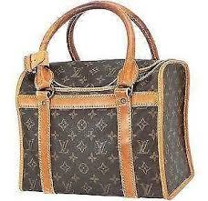
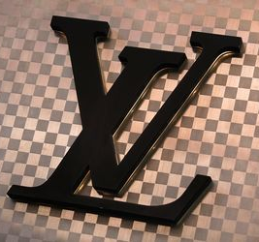
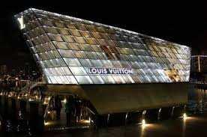
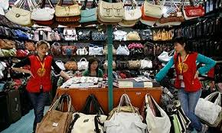
Objectives
This work is innovative in this field, as it explores and aggregates constructs that are associated with Consumer-Brand Relationships, as self-image and brand attachment as antecedents of purchase of luxury brand´s counterfeits .

Slide 7
Conceptual Background
In order to identify the antecedents of counterfeit luxury products’ purchase, a literature review of previous studies was accomplished. The first empirical study that was used to propose the hypothetical model of this research was accomplished in Korea, with 324 respondents by Yoo & Lee (2009).
The results revealed that the most relevant impacts on purchasing counterfeits are: past purchases of fakes, hedonic benefits, materialism (personality trait) and economic benefits.

Slide 8
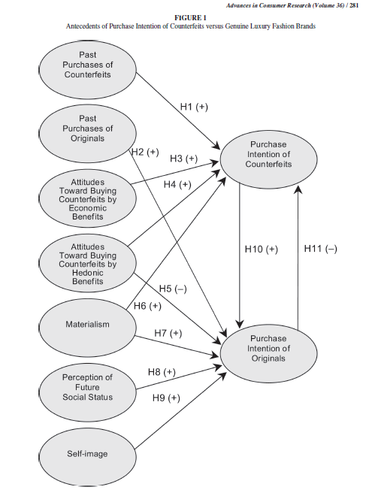

Slide 9
Conceptual Background
Another relevant study about the theme was developed by Raza et. al. (2014).
These authors explored the relations among brand attachment, low prices, attitude towards the counterfeits, brand image and past experiences with the purchasing intentions of mobile phones.
Past experiences with counterfeits demonstrated a strong impact on purchasing intentions.
Attitudes about counterfeits also presented a significant impact, but brand attachment and brand image did not present any relevant impacts over the purchasing intention in this market, probably because mobile phones were not considered to be luxury products.

Slide 10
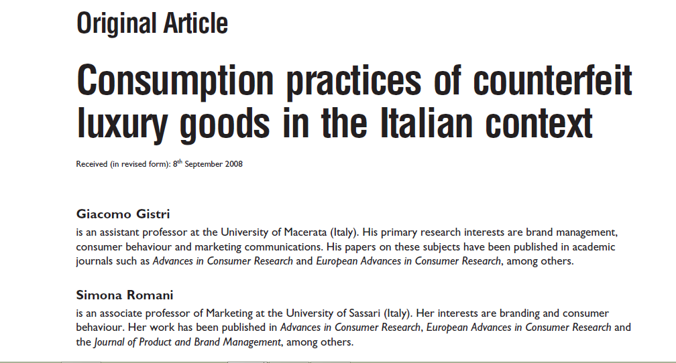
Conceptual Background
Chiu et. al. (2009) conducted a research in Taiwan with 384 respondents, and observed that utilitarian benefits had a higher influence in the loyalty towards the originals, than the hedonic benefits, when considering luxury brands as the object of the study.
Considering the aspects related to the consumer’s identity, we verified that Gistri et al. (2009) conducted an interesting qualitative research in Italy. According to these authors, counterfeits products lack identity, as they are always evaluated by their “alter ego”: the originals.
They reported that producers could argument that efforts to make the fake somehow real would be ineffective, since the product´s “soul” would remain unauthentic. These authors suggest that an individual cannot enhance his/her identity on faking roots; despite the fact that he/she may attempt to extent his/her self to the members of a social group by exhibiting fake products (Gistri et al.2009)

Slide 11
Antecedents
Attitudes towards counterfeits: economic benefits and hedonic benefits
Brunk (2012) argues that the utilitarian theory is consequentialist by nature, which means that it tries to follow its own rule or take an alternate route about decision-making of gains and losses. Therefore, consumers that purchase counterfeit products would be seeking for hedonic or economic benefits. According to Yoo & Lee (2009), when consumers have more hedonic benefits than utilitarian needs, they will easily accept counterfeiting items. Chiu et. al. (2009) says that the value represents the individual’s evaluation after his or her interaction experience with the objects. Hedonic benefits are more subjective and related to issues, such as: pleasure, personal benefits, self-expression and entertainment (Ahtola, 1985, Babin et. al.,1995), Yoo & Lee (2009) observe that economic values are one of the main antecedents of purchasing counterfeits, since the consumers believe that they can have similar benefits from counterfeit goods, when compared with the genuine products. Considering these arguments, the following hypotheses were proposed:
H1: Hedonic Benefits have a positive effect on the purchasing intention of counterfeit products.
H2: Hedonic Benefits have a positive effect on the purchasing intention of genuine products.
H3: Economic Benefits have a positive effect on the purchasing intention of counterfeit products.
H4: Economic Benefits have a negative effect on the purchasing intention of genuine products.

Slide 12
Antecedents
2.2 Materialism
According to Johnson (2009), materialism is the attached importance on possession and acquisition of material goods, seeking to achieve life goals and desired comfort conditions (Phau et al. 2009; Park &Burns, 2005, Harum, 2012). Yoo & Lee (2009), argue that the materialism embodies those consumers who tend to ignore the negative consequences of counterfeiting, such as threats to the consumers' safety and health, losses for the economies and national societies and damages to the reputation of a genuine brand. When consumers are not aware of these consequences, they are more likely to purchase counterfeit products, moved by a materialistic desire. Thus, the following hypotheses were proposed:
H5: Materialism has a positive effect on the purchasing intention of counterfeit products.
H6: Materialism has a positive effect on the purchasing intention of genuine products.

Slide 13
Antecedents
2.3 Self Image
According to Kernis (2003), a good self-image is considered to be one of the strongest psychogenic needs of human beings, because it encourages people to feel good about themselves. According to Malar et al. (2011), the self-verification theory indicates that people are motivated to validate and to be consistent with their existing self-concepts, and tend to behave in a manner consistent with how they see themselves. The same happens with the ideal self, which supports them in their self-enhancement activities by giving them a feeling of getting closer to their ideal self (Malar et al. 2011; Grubb & Grathwohl 1967).
Mourad & Valette-Florence (2011) argue that the self-image is related to the purchasing intent for counterfeit products. They hypothesize that consumers have the desire to undergo an experience of being in another "self", and this desire can contribute to increase the purchasing intentions of either counterfeits or genuine goods. Similarly, Yoo & Lee (2009) suggest that a positive self-image impact on the decision to purchase genuine products, a fact that was confirmed by the different studies thought an empirical research (Mourad & Valette-Florence, 2011). However, they do not explore if the ownership of counterfeit products could enhance the consumer´s self-image, as the owner knows the origin of the fake product, differently from the participants of his/her social group, that do not have this private information.
Seeking to explore the impact of purchasing intention of either genuine or counterfeit products on the self-image, the following hypotheses were formulated:
H7: Purchasing intention of counterfeit products has a positive effect on the Self-image.
H8: Purchasing intention of genuine products has a positive effect on the Self-image.

Slide 14
Antecedents
2.4 Brand Attachment and Self Congruence
Park et al. (2010) point out that companies have been increasingly working to create a strong emotional connection between their consumers. Studies, such as the one conducted by Mourad & Valette-Florence (2011), propose that the consumer’s relationships with brands as being antecedents of purchases of either counterfeits or genuine goods.
Penz & Stöttinger (2012) observed, as findings of a study with eight focus groups in the EU, that emotional aspects are important drivers of purchasing decisions of counterfeits. The results indicated different patterns of positive, negative or mixed emotions as antecedents of purchasing originals and fakes products. Raza et al. (2014) accomplished a study to verify if brand attachment and brand image caused an impact on the purchasing intention of counterfeits, but the hypothesis were rejected. They worked with mobile phones as the product’s category in their study. The findings suggested that different outcomes can be reached in markets of products that are considered to be more expensive and luxurious. In this sense, the following hypotheses were proposed:
H9: Real self-congruence has a positive effect on brand attachment.
H10: Ideal self-congruence has a positive effect on brand attachment.
H11: Brand attachment has a positive effect on the purchasing intention of original products.
H12: Brand attachment has a negative effect on purchasing intention of counterfeit products.

Slide 15
Antecedents
2.5 Purchase intention of Originals
Yoo & Lee (2009) argument that consumers who prefer legitimate products, do not desire the counterfeit products and that they are more satisfied with the originals than the counterfeits. According to these authors, experiences with original products provide more satisfaction because of a better physical quality and interpersonal approval of the products, and that these characteristics can reduce the interest in counterfeits. Therefore, we hypothesize:
H13: Purchasing intention of originals negatively affects the purchasing intention of counterfeit products.

Slide 16
Methodology
A survey was conducted among 532 women in Brazil.
Personal surveys were developed among the middle class (C class).
According to previous studies, 56% of the consumers of this social class had bought at least one fake product during the last year (Infomoney, 2013).
The questionnaire’s first question explored the interest of the respondent in buying a luxury handbag. Respondents with low scores of interest were discarded.
They were also asked to indicate a luxury handbag brand that they would like to buy. All the answers of the questionnaire were related to this specific brand.

Slide 17
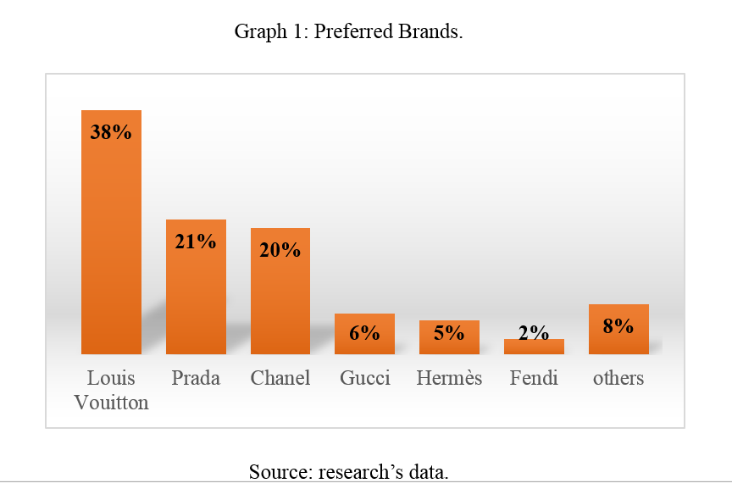

Slide 18
Scales
The survey’s instrument was operationalized through validated scales from previous studies: Brand Attachment (Park, MacInnis, Eisingerrich & Iacobucci, 2010); Actual and Ideal Self Congruence (Malär, L., Krohmer, H., Hoyer, W. D. & Nyffenegger, B., 2011); Hedonic and Economic Benefits of Counterfeits Products (Lee, Chang, Hsieh & Chiu (2009); Self Image, Materialism and Intention to buy Counterfeits and Originals (Yoo & Lee, 2009).

Slide 20
Results
2.6 Analysis of the Model and Conclusions
The proposed Hypothetical model was capable of explaining 61% (R²) of the purchasing intention of counterfeits and 53% of purchasing intention of originals.
Findings of this structural model showed that, the stronger the purchasing intentions in buying counterfeits, lower the purchasing intentions would be to buy the originals.
.

Slide 21
Results
At this point, we can verify that the buyers of counterfeits are looking for hedonics benefits originated from the social group, that they are not attached to the brand and do not have their self-image enhanced with the ownership of a fake product.
For them, the brand acts more like an instrument for pleasure in front of the others, and it is “used” as a tool/object with which he/her has low emotional bonds and attachment with the brand.

Slide 22
Comparing Emerging and Developed Economies
Considering the difference of the consumer behavior’s potential, due to cultural and economic influences from previous studies, we decided to compare the results of this work with a research conducted among the women from South Korea, carried out by Yoo & Lee (2009). Concerning the impacts of economic benefits on the purchasing intentions of counterfeits, in Brazil there is a stronger influence of the economic benefits (B=0.53) than in South Korea (B=0.10), Comparing both countries, it is possible to observe that Brazil has lower incomes than South Korea, fact that could have had influence in these results.
The impact of hedonic benefits on the purchasing intention of counterfeits presented differences among the samples. According to the results, the Brazilian sample presented a weight of 0.34 (hedonic benefits->purchase intentions of counterfeits). However, the impact in South Korea was lower, of about 0.21. This means that the Brazilians are more hedonically, in the aspects regarding the purchase of luxury counterfeits. Hedonic benefits also presented significant impacts on the purchasing intention of originals in Brazil, reinforcing the right level of hedonism that is present in the luxury purchases in this country.
Materialism (personality trait) presented similar behavior in both samples: for Koreans and Brazilians, it was observed that consumers of genuine products are more materialistic than consumers of counterfeit products. Similar findings were found in a study conducted in India with the consumers of luxury products (Srinivasan, Srivastava & Sandeep, 2014).

Slide 23
Contributions and Implications
As consequences of these results, consistent managerial implications can emerge. One of them is the opportunity for CMOs to communicate that the consumer´s self-image will not be enhanced through the ownership of counterfeits, as the owners have conscience that the product is a fake.
They can also work to increase brand attachment in order to reduce the counterfeit purchases. For the society in general, this paper can contribute with the strategies that induce a more ethical consumer-brand relationship behavior, reducing counterfeiting. The research innovates, as it arguments that consumer-brand relationships concepts (as brand attachment and self-congruence) have a key role in shaping anti-counterfeiting strategies. In this sense, new hypotheses about how consumer-brand relationships can affect counterfeiting should be proposed and explored.
Considering how important the counterfeiting is for firms and economies, it is possible to observe that this is a relevant field of study, which can be useful for the creation and development of theoretical and empirical backgrounds thought empirical studies, in order to understand and mitigate this critical societal phenomena.

Slide 24


Thanks !
-01 00 00

Slide 25
Antecedents of Fraud of Electric Power done by Consumers (steal energy at home)
Crime Theory (Crime Life Styles) Walters (1990).
No relation with lack of Money
Consumers use the saved money to buy new objects or pay diferente bills

